Slide 1



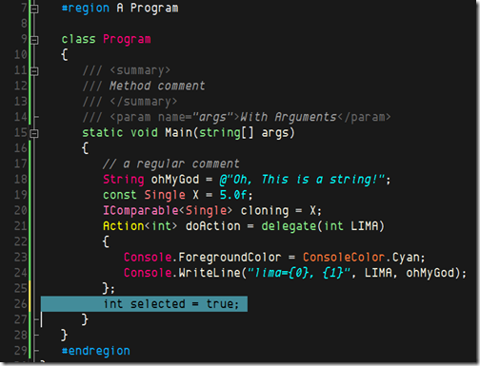


Code Tuning and Optimization
When and How to Improve Code Performance
High-Quality Code
SoftUni Team
Technical Trainers
http://softuni.bg
Software University

Slide 2

Table of Contents
Computer Performance
Code Tuning
dotTrace
C# Optimization Tips

Slide 3

Computer Performance

Slide 4
What is Performance?
Computer performance is characterized by the amount of useful work accomplished by a computer system compared to the time and resources used.
Аn aspect of software quality that is important in human–computer interactions
Resources:
en.wikipedia.org/wiki/Computer_performance
C#: http://www.dotnetperls.com/optimization

Slide 5
Good Computer Performance
Good computer performance:
Short response time for a given piece of work
High throughput (rate of processing work)
Low utilization of computing resource(s)
High availability of the computing system or application
Fast (or highly compact) data compression and decompression
High bandwidth / short data transmission time

Slide 6
Actual vs. Perceived Performance
Example: "Vista's file copy performance is noticeably worse than Windows XP" – false:
Vista uses algorithm that perform better in most cases
Explorer waits 12 seconds before providing a copy duration estimate, which certainly provides no sense of smooth progress
The copy dialog is not dismissed until the write-behind thread has committed the data to disk, which means the copy is slowest at the end
Notes:
Fixed in SP1

Slide 7
Is Performance Really a Priority?
Performance improvements can reduce readability and complexity
"Premature optimization is the root of all evil."
Donald Knuth
"More computing sins are committed in the name of efficiency (without necessarily achieving it) than for any other single reason – including blind stupidity."
W. A. Wulf

Slide 8
How to Improve Performance?
Software requirements
Software cost vs. performance
System design
Performance-oriented architecture
Resource-reducing goals for individual subsystems, features, and classes
Class and method design
Data structures and algorithms

Slide 9
How to Improve Performance? (2)
External Interactions
Operating system
External devices – storage, network, Internet
Code Compilation / Code Execution
Compiler optimizations
Hardware
Very often the cheapest way
Code Tuning

Slide 10

Code Tuning Concepts

Slide 11
Introduction to Code Tuning
What is code tuning / performance tuning?
Modifying the code to make it run more efficiently (faster)
Not the most effective / cheapest way to improve performance
Often the code quality is decreased to increase the performance
The 80 / 20 principle
20% of a program's methods consume 80% of its execution time

Slide 12
Systematic Tuning – Steps
Systematic code tuning follows these steps:
Assess the problem and establish numeric values that categorize acceptable behavior
Measure the performance of the system before modification
Identify the part of the system that is critical for improving the performance
This is called the bottleneck
Modify that part of the system to remove the bottleneck

Slide 13

Systematic Tuning – Steps (2)
Measure the performance of the system after modification
If the modification makes the performance better, adopt it
If the modification makes the performance worse, discard it

Slide 14
Code Tuning Myths
"Reducing the lines of code in a high-level language improves the speed or size of the resulting machine code" → false!
a[1] = 1
a[2] = 2
a[3] = 3
a[4] = 4
a[5] = 5
a[6] = 6
a[7] = 7
a[8] = 8
a[9] = 9
a[10] = 10
for i = 1 to 10
a[i] = i
end for
vs.

Slide 15

Code Tuning Myths (2)
"A fast program is just as important as a correct one" → false!
Above all, the software should work correctly!

Slide 16

Code Tuning Myths (3)
"Certain operations are probably faster or smaller than others" → false!
E.g. "add" is faster than "multiply"
Always measure performance!
"You should optimize as you go" → false!
It is hard to identify bottlenecks before a program is completely working
Focus on optimization detracts from other program objectives
Performance tuning breaks code quality!

Slide 17
When to Tune the Code?
Use a high-quality design
Make the program right
Make it modular and easily modifiable
When it's complete and correct, check the performance
Consider compiler optimizations
Measure, measure, measure
Write clean code that's easy to maintain
Write unit tests before optimizing

Slide 18
When to Tune the Code (2)?
Junior developers think that "selection sort is slow"? Is this correct?
Answer: depends!
Think how many elements you sort
Is "selection sort" slow for 20 or 50 elements?
Is it slow for 1,000,000 elements?
Shall we rewrite the sorting if we sort 20 elements?
Conclusion: never optimize unless the piece of code is proven to be a bottleneck!

Slide 19

Measurement
Measure to find bottlenecks
Measurements need to be precise
Measurements need to be repeatable

Slide 20
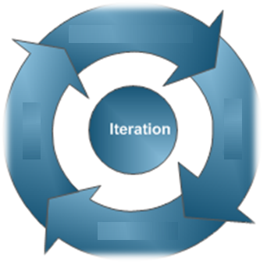
Optimize in Iterations
Measure improvement after each optimization
If optimization does not improve performance → revert it
Stop testing when you know the answer

Slide 21
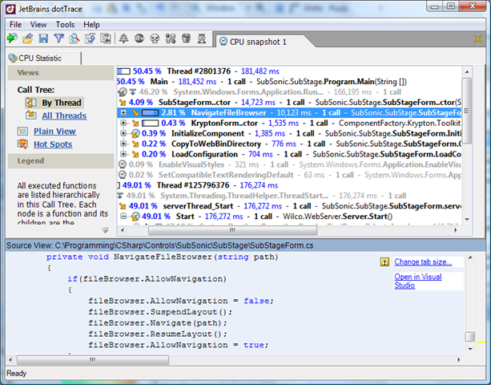
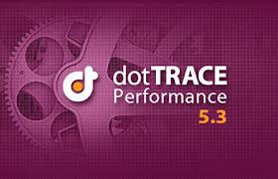
dotTrace
.NET Code Profiler

Slide 22
What is dotTrace?
What is dotTrace?
A performance analysis tool
Also called profiler
Designed for code and memory profiling
Measures the frequency and duration of function calls
Traces the call stack
Collects information about memory usage

Slide 23
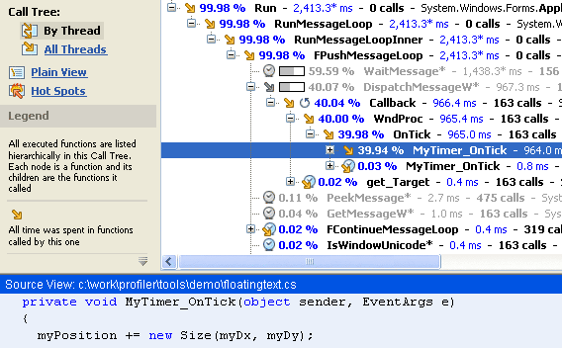
dotTrace Live Demo
Profiling and Improving Performance

Slide 24
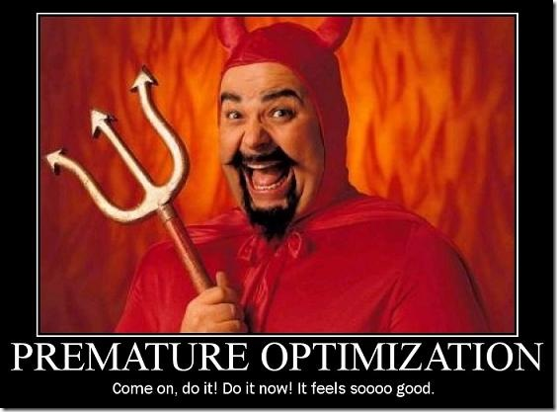
C# Code Optimizations
http://www.dotnetperls.com/optimization

Slide 25
Do We Need Optimizations?
The C# language is fast
A bit slower than C and C++
Is it worthwhile to benchmark programming constructs?
We should forget about small optimizations
Say, about 97% of the time: premature optimization is the root of all evil
At all levels of performance optimization
You should be taking measurements on the changes you make

Slide 26
Benchmarking with Stopwatch
Stopwatch measures time elapsed
Useful for micro-benchmarks optimization
using System.Diagnostics;
static void Main()
{
Stopwatch stopwatch = new Stopwatch();
stopwatch.Start();
// Do something …
stopwatch.Stop();
Console.WriteLine("Time elapsed: {0}", stopwatch.Elapsed);
}

Slide 27
C# Optimization Tips
Static fields are faster than instance fields
Instance methods are always slower than static methods
To call an instance method, the instance reference must be resolved first
Static methods do not use an instance reference
It is faster to minimize method arguments
Even use constants in the called methods instead of passing them as arguments
This causes less stack memory operations

Slide 28
C# Optimization Tips (2)
When you call a method in a C# program
The runtime allocates a separate memory region to store all local variable slots
This memory is allocated on the stack
Sometimes we can reuse the same variable
Well-known anti-pattern for quality code
Constants are fast
Constants are not assigned a memory region, but are instead considered values
Injected directly into the instruction stream

Slide 29
C# Optimization Tips (3)
The switch statement compiles in a different way than if-statements typically do
Some switches are faster than if-statements
Using two-dimensional arrays is relatively slow
We can explicitly create a one-dimensional array and access it through arithmetic
The .NET Framework enables faster accesses to jagged arrays than to 2D arrays
Jagged arrays may cause slower garbage collections

Slide 30
C# Optimization Tips (4)
StringBuilder can improve performance when appending strings
Using char[] may be the fastest way to build up a string
If you can store your data in an array of bytes, this allows you to save memory
Smallest unit of addressable storage – byte
Simple array T[] is always faster than List<T>
Using efficient data structures (e.g. HashSet<T> and Dictionary<K,T>) may speed-up the code

Slide 31
C# Optimization Tips (5)
Use lazy evaluation (caching)
for-loops are faster than foreach loops
foreach uses enumerator
C# structs are slower (in most cases)
Structs are copied in their entirety on each function call or return value
public int GetSize()
{
if (this.size == null)
size = CalculateSize();
return this.size;
}

Slide 32
C# Optimization Tips (6)
Instead of testing each case using logic, you can translate it through a lookup table
It eliminates costly branches in your code
It is more efficient to work with a char instead of a single-char string
Use ILSpy or any other decompilation tool to view the output IL code
Use Debug → Windows → Disassembly in VS
Don't do unnecessary optimizations!
Measure after each change

Slide 33

Which is the Fastest?
string str = new string('a', 5000000);
int count = 0;
for (int i = 0; i < str.Length; i++)
if (str[i] == 'a')
count++;
int count = 0;
int len = str.Length;
for (int i = 0; i < len; i++)
if (str[i] == 'a')
count++;
int count = 0;
foreach (var ch in str)
if (ch == 'a')
count++;

Slide 34
Optimization Tips – Inline Code
Manual or compiler optimization that replaces a method call with the method body
You can manually paste a method body into its call spot or let the compiler decide
Typically, inline code improves performance in micro-benchmarks
… but makes the code hard to maintain!
In .NET 4.5 you can force code inlining:
[MethodImpl(MethodImplOptions.AggressiveInlining)]
void SomeMethod() { … }

Slide 35
Choosing the Correct Approach
Using an inappropriate data structure or algorithm is often the reason for a bottleneck
Which data structure is most appropriate?
Store people in a phonebook
Append thousands of strings
Store a fixed set of variables
Save how a game of chess progresses (move by move)
-> Dictionary
-> StringBuilder
-> Array
-> Stack

Slide 36
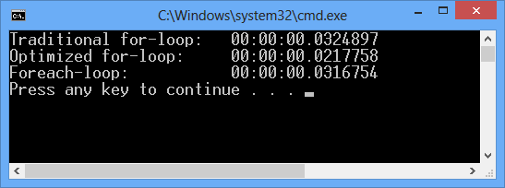
Measuring Performance in C#
Live Demo

Slide 37

Code Tuning and Optimization
Exercises in Class

Slide 38
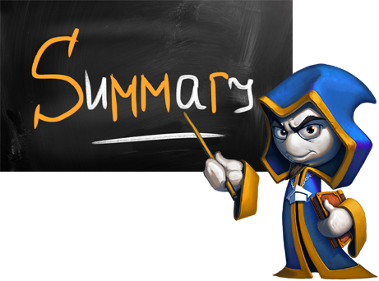
Summary
Do not improve performance unless needed
Use a reliable tool to measure performance
Ensure the optimized code runs faster

Slide 39









Code Tuning and Optimization
http://softuni.org/courses/high-quality-code

Slide 40

License
This course (slides, examples, demos, videos, homework, etc.) is licensed under the "Creative Commons Attribution-NonCommercial-ShareAlike 4.0 International" license
Attribution: this work may contain portions from
"Fundamentals of Computer Programming with C#" book by Svetlin Nakov & Co. under CC-BY-SA license
"C# Part I" course by Telerik Academy under CC-BY-NC-SA license

Slide 41






Free Trainings @ Software University
Software University Foundation – softuni.org
Software University – High-Quality Education, Profession and Job for Software Developers
softuni.bg
Software University @ Facebook
facebook.com/SoftwareUniversity
Software University @ YouTube
youtube.com/SoftwareUniversity
Software University Forums – forum.softuni.bg

